Slide 1

RangeAnx Reducer (RR)
- Karunya Harikrishnan
- Malathi M
Shiv Nadar University Chennai

Slide 2

WHY ?
The entire auto industry across the globe is shifting from conventional mode to all electric i.e., all the systems are to be powered by batteries.
When it comes to battery, lithium – ion battery (LiB) is taking front seat compared to its counterparts.
The three major factors influencing, rather hindering the earlier adaptation of EV are
Calendar ageing – self discharge of the battery
Cycle ageing – repeated charge and discharge of the battery
Safety – Though LiB has a great energy density, the heat generated during charging and discharging deteriorates the performance and leads to safety issues.

Slide 3
Why RangeAnx Reducer ?
The discussed factors leave customers with range anxiety, life anxiety etc., hence preventing change.
“ Nobody wants to be in the middle of nowhere with a dead battery”
So, it is important to have prior information about the Remaining Useful Life (RUL) or End Of Life (EOL)
This project aims to estimate the RUL of a LiB with a reasonably good accuracy.
We aim to build a Deep Learning based prediction model to predict the RUL of the LiB using the data collected from previous research papers in the same field of study keeping in mind the obstacles presented by constant data fluctuations.

Slide 4
Remaining Useful Life (RUL)
The RUL of a lithium – ion battery is the amount of time that the battery is expected to be able to perform its intended function before it fails or needs to be replaced.
Factors that affect the RUL of a lithium – ion battery
Temperature
Current and voltage across the terminals
Charging and discharging rate of batteries.

Slide 5
Our Methodology
Using the EV battery data from the internet we intend to build a Black Box neural network that would estimate the remaining useful life (RUL) of an EV’s battery.
The black box battery model will be a data driven model.
The developed model will be cross verified using experimental data.

Slide 6
Our Workflow
Battery Raw Data
Training Set
Learning AI model LSTM
Data pre-processing Normalization
Test Set
Estimation model
Split Data into Training, Validation and Test Set
Performance Evaluation
V,I,T Capacity Data

Slide 7
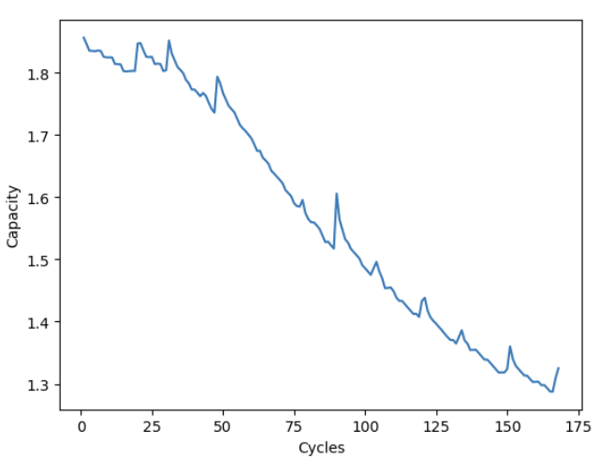
Behaviour of Capacity over a period of time
From the graph it can be inferred that the capacity of the battery degrades over time.
The capacity of the battery almost degrades by 50% over 170+ cycles.
Source : NASA Li-ion Battery Aging Datasets

Slide 8
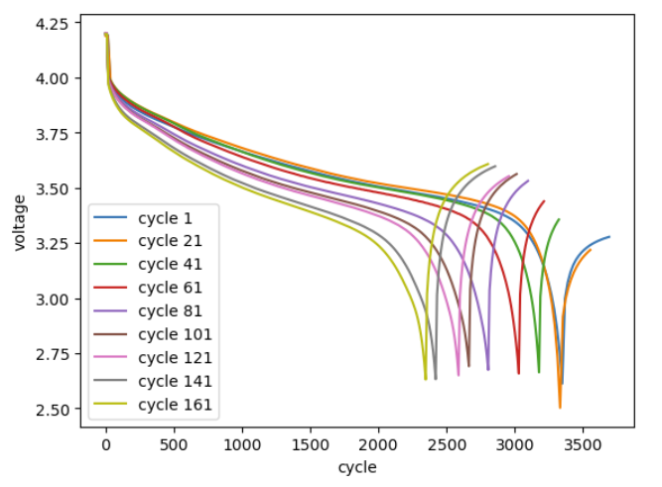
Behaviour of Voltage over a period of time
From the graph it can be inferred that the total voltage reduction in cycle 1 takes much longer than the total voltage reduction in cycle 161
i.e., voltage in cycle 1 lasts for almost 3500 seconds whereas in cycle 161 it only lasts nearly 2500 seconds
Hence the efficient time of usage is reduced by 1000 seconds in 160 cycles
Source : NASA Li-ion Battery Aging Datasets

Slide 9
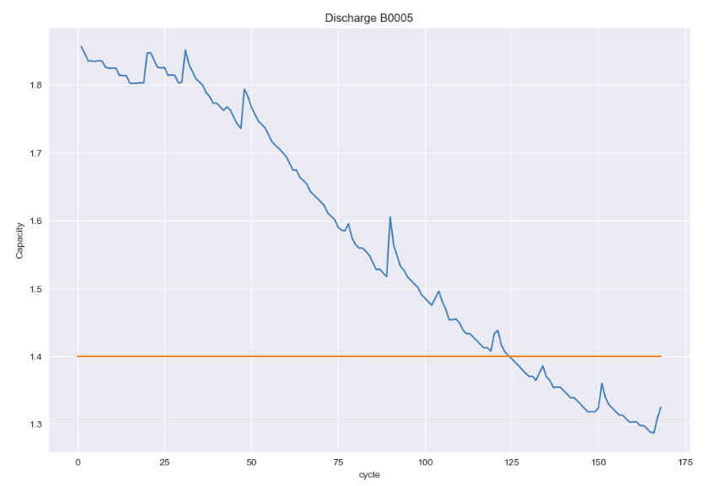
Fixing a threshold
Usually the manufacturer decides the threshold until which the battery will be efficient when used.
Here, for a 2Ah capacity battery the threshold will be 70% of its total capacity i.e., 1.4Ah
After the degradation, the battery’s efficient capacity reduces drastically rendering it unusable.

Slide 10
Why choose LSTM?
LSTMs are predominately used to learn, process, and classify sequential data because these networks can learn long-term dependencies between time steps of data.
LSTMs were developed to deal with the vanishing gradient problem that can be encountered when training traditional RNNs.
Why not GRU ?
Though GRU NN has a fewer data dependencies, lighter structure, fewer parameters but LSTMs have an explicit memory cell that can be updated and read at different times, while the information in GRUs are blended in the hidden state. As a result, LSTMs tend to be more powerful and expressive than GRUs, and are able to capture more complex dependencies in the data

Slide 11
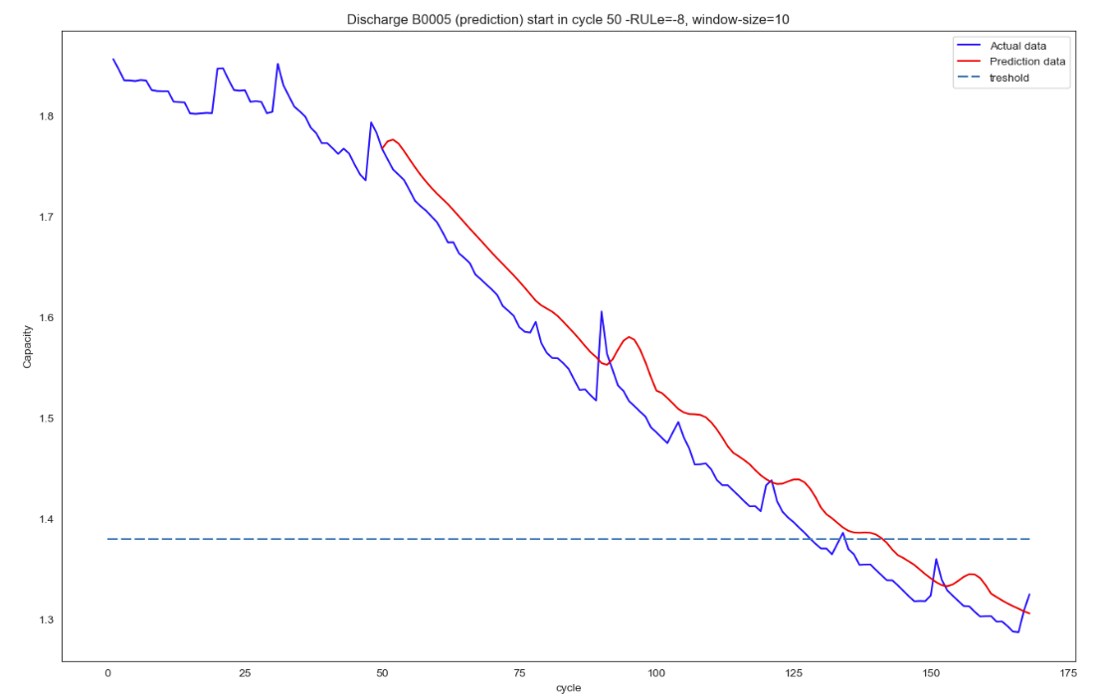
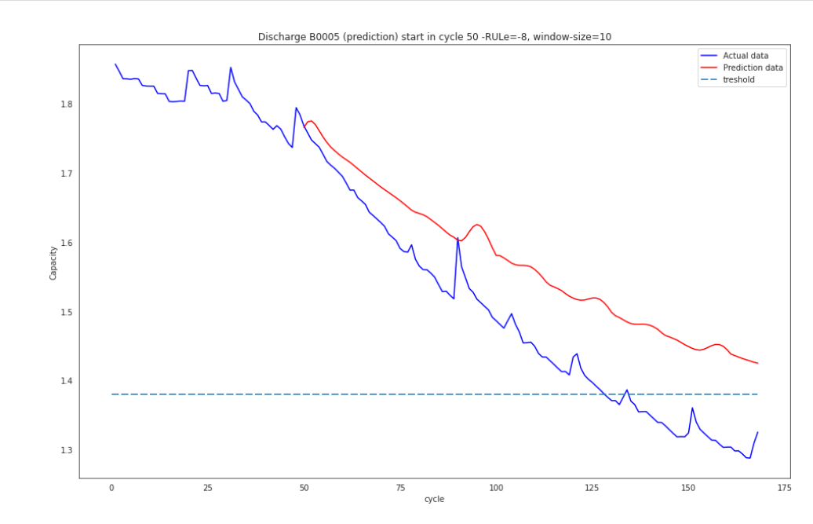

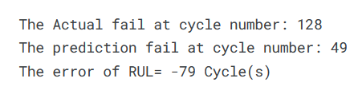
OUR RESULTS VS PRIOR ART RESULTS

Slide 12

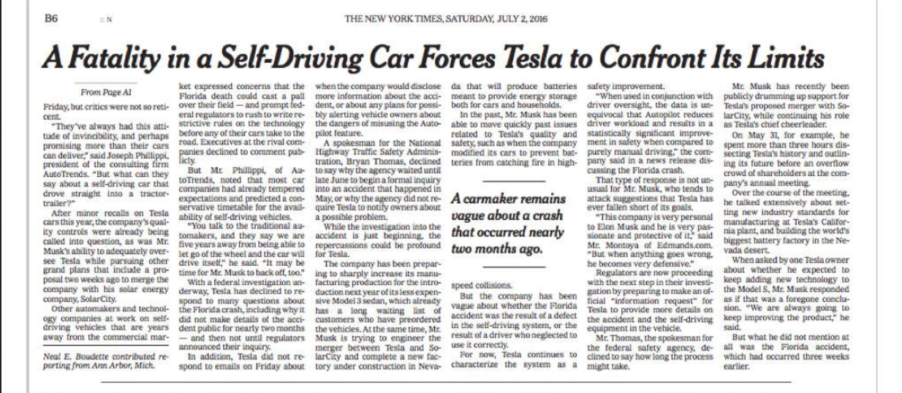
This project is an attempt to make EVs cost saving,life saving future of the automobile industry

Slide 13
Key Features & Future Scope :
This project is an attempt to realize accurate EOL prediction of EV batteries and can further be improved as a more viable product by combining the other dynamic environment changes that affect the battery health such as Driving patterns, gradual temperature changes etc that can help reduce Range Anxiety to a further extent thus making the transformation to EV more practical.

Slide 14
REFERENCES
Dataset : https://www.kaggle.com/code/sameerudgirkar/anomaly-detection-on-battery-health-nasa-dataset/data
Research papers
[1] Liu, D.; Zhou, J.; Liao, H.; Peng, Y.; Peng, X. A health indicator extraction and optimization framework for lithium-ion battery degradation modeling and prognostics. IEEE Trans. Syst. Man Cybern.-Syst. 2015, 45, 915–928.
[2] Patil, M.A.; Tagade, P.; Hariharan, K.S.; Kolake, S.M.; Song, T.; Yeo, T.; Doo, S. A novel multistage Support Vector Machine based approach for Li ion battery remaining useful life estimation. Appl. Energy 2015, 159, 285–297. [CrossRef]
[3] Zhang, Y.; Xiong, R.; He, H.; Pecht, M.G. Long short-term memory recurrent neural network for remaining useful life prediction of lithium-ion batteries. IEEE Trans. Veh. Technol. 2018, 67, 5695–5705. [CrossRef]
[4] Hussein, A.A. Capacity fade estimation in electric vehicle li-ion batteries using artificial neural networks. IEEE Trans. Ind. Appl. 2015, 51, 2321–2330. [CrossRef]
8] Wang, Z.; Ma, Q.; Guo, Y. Remaining Useful Life Prediction of Lithium-Ion Batteries Based on Deep Learning and Soft Sensing. Actuators 2021, 10, 234. https://doi.org/10.3390/act10090234

